Slide 1
Linear Control Systems

Slide 2
Module 1: Lecture 1
Introduction to
Systems and Control

Slide 3






What is a System?
A collection of physical, biological or abstract components which together
perform an intended objective
A system gives an output (also called response) for an input (also called excitation)
Input /
Excitation
System
Output /
Response
System can be a collection of multiple sub-systems
SS2
Input /
Excitation
Output / Response
SS1
+
SS3
SS4
System (with 4 sub-systems)

Slide 4
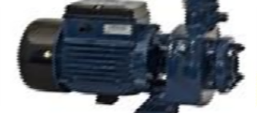
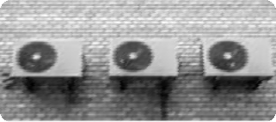

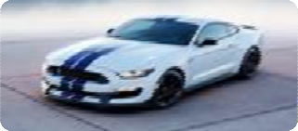
Examples of System
Motor
Input – Electrical energy (voltage)
Output – Mechanical energy (Torque / Rotation)
Air conditioner
Input – Electrical energy (voltage)
Output – Heat energy (Changes the ambient temperature)
Human body infected with a virus
Input – Drug administration
Output – Drug distribution & effect on the body
Vehicle (car or bus)
Input – Acceleration or Deceleration
Output – Vehicle displacement

Slide 5
Nomenclature
Some of the basic symbols to be used in this course:
S.No. | Variable Name | Symbol | Description
1 | Time | 𝑡 | Time instant
2 | Input | 𝑢(𝑡) | Input signal given to the system at time 𝑡
3 | Output | 𝑦(𝑡) | Output signal of the system at time 𝑡
4 | Delay | 𝛿 | Time delay in a signal
5 | Disturbance | 𝑤(𝑡) | Disturbance affecting the system at time 𝑡
6 | Function | 𝑓 | A defined relation between a set of variables

Slide 6
Classification of Systems
Variety of classifications are possible based on system features and applications
Some of the important classifications include:
Linear and non-linear systems
Static and dynamic systems
Time invariant and time variant systems
Causal and non-causal systems

Slide 7
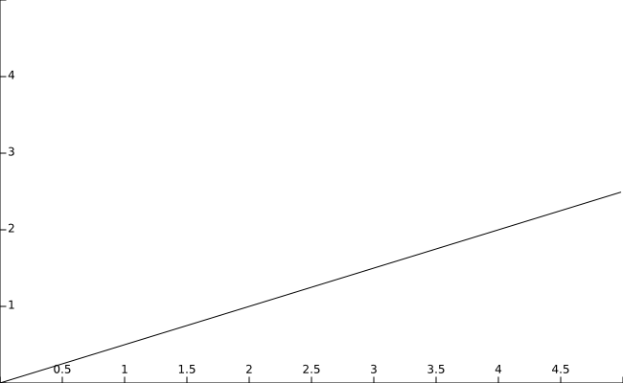
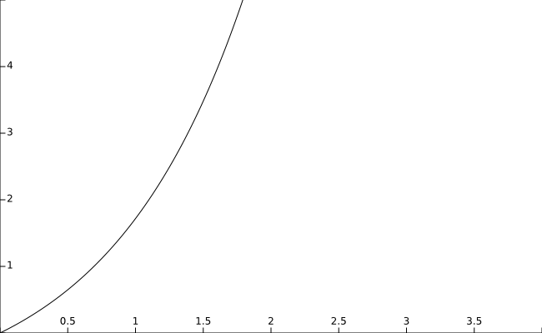
Linear Vs Non-Linear Systems
Linear systems
Output of the system varies
linearly with input
Satisfy homogeneity and
superposition
𝑉
Non-linear systems
Output of the system does
not vary linearly with input
Do not satisfy homogeneity
and superposition
𝑉
E.g. Diode: 𝐼 = 𝐼₀(𝑒 ^{𝜏} − 1)
E.g. Resistor : 𝐼 =
𝑅
I
I
𝑉
𝑉
Module 1: Lecture 1
7

Slide 8
Static Vs Dynamic Systems
Dynamic systems
Output of the system depends on present as well as past inputs
Presence of memory can be
observed
𝑦 𝑡 = 𝑓(𝑢 𝑡 , 𝑢 𝑡 − 1 ,
𝑢 𝑡 − 2 , … )
E.g. Inductor:
Static systems
At any time, output of the system depends only on present input
Memory less systems
𝑦 𝑡 = 𝑓(𝑢 𝑡 )
E.g. Resistor:
𝐼(𝑡) = ^{𝑉(𝑡)}
1
𝑡
𝑅
𝐼(𝑡) = _{𝐿} 𝑉(𝑡)𝑑𝑡
0

Slide 9
Time Invariant Vs Time Variant Systems
Time variant systems
Output of the system varies dependent on the time at which input is applied
Time invariant systems
Output of the system is independent of the time at which the input is applied
𝑦 𝑡 = 𝑓 𝑢 𝑡 ⇏ 𝑦 𝑡 + 𝛿 =
𝑓(𝑢 𝑡 + 𝛿 )
E.g. Aircraft: Mass (𝑀) of aircraft changes as fuel is consumed
𝑦 𝑡 = 𝑓 𝑢 𝑡 ⟹ 𝑦 𝑡 + 𝛿 =
𝑓(𝑢 𝑡 + 𝛿 )
E.g. An ideal resistor
𝑉 𝑡
𝑉(𝑡 + 𝛿)
𝐼 𝑡 =
⟹ 𝐼 𝑡 + 𝛿
₌ 𝐹(𝑡)
𝑅
𝑅
Acceleration: 𝑎 𝑡
𝑀(𝑡)

Slide 10
Causal Vs Non-causal Systems
Causal systems
Output is only dependent on inputs already received (present or past)
Non-anticipatory system
•
•
Non-causal systems
Output depends on future
inputs as well
System anticipates future inputs based on past
𝑦 𝑡 = 𝑓(𝑥 𝑡 , 𝑥 𝑡 + 1 , . . )
E.g.
Weather forecasting system
Missile guidance system
𝑦 𝑡 = 𝑓(𝑥 𝑡 , 𝑥 𝑡 − 1 , . . )
E.g.
Thermostat based AC
Motor or generator

Slide 11
What is a Control System?
A system or mechanism which directs the input to other systems and regulates their output
Control system alters the response of a plant or system as
desired
Desired Reference
Control Input
Plant or
System
To be controlled
Controller
Output
Control System

Slide 12
Disturbance
Unwanted signals which affect the output of the system
E.g. People entering and leaving an AC room disturbs room
temperature
Controller has to eliminate the effects of disturbance
Disturbance
Desired Reference
Control Input
Plant or System
To be controlled
Output
Controller
Control System

Slide 13
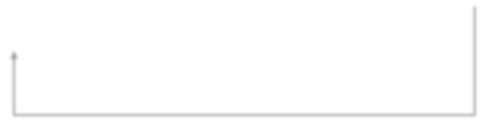
Feedback in Control
Feedback senses the plant output and gives a signal which can be compared to the reference
Controller action (control input) changes based on feedback
Feedback enables the control system in extracting the desired
performance from the plant even in presence of disturbance
Disturbance
Desired
Reference
Control Input
Plant or System
To be controlled
Response / Output
Controller
Control System
Feedback

Slide 14









Examples of Control Systems
Actual temp
Temp
Setting knob
On
Off Switch
Air
Conditioned
Room
What is the process or plant?
What is the output?
What is the desired input?
What are the subsystems?
What is the actuator?
Module 1: Lecture 1
14

Slide 15
Examples of Control Systems
Air conditioner maintaining desired temperature:
Plant
Control system
Reference
Control Input
Output
Disturbance
Feedback
: Room
: Air Conditioner
: Desired temperature
: Compressor ON/OFF
: Output temperature
: Factors affecting ambient temperature
: Measured temperature
People in the Room
Desired Temperature
Temperatur e Setting Knob
ON OFF
Switch
Air Conditioner
Room
Actual Temperature
15

Slide 16
Examples of Control Systems
Human steering an automobile:
Plant
Control system
Reference
Control Input
Output
Disturbance
Feedback
: Vehicle or automobile
: Human control
: Desired destination
: Steering mechanism
: Actual position
: Traffic conditions
: Sensing (Human Senses)
Traffic conditions
Desired
Destination
Human Control
Steering
Mechanism
Vehicle / Automobile
Actual position
Sensing
16

Slide 17
Overview
Summary : Lecture 1
System with examples
Classification of systems
Control system & examples
Feedback & its significance
Contents : Lecture 2
Model & its significance
Types of math models
Methods of modelling systems
Steps of modelling systems
17

